Slide 1


YOUR QUALITY PARTNER FOR SOFTWARE SOLUTIONS
5G Use cases: Cellular V2X Communication
Sierra Wireless Validation Team
TMA Solutions
www.tmasolutions.com

Slide 2
Agenda
Introduction
…
…
Conclusion
Reference
Q & A

Slide 3
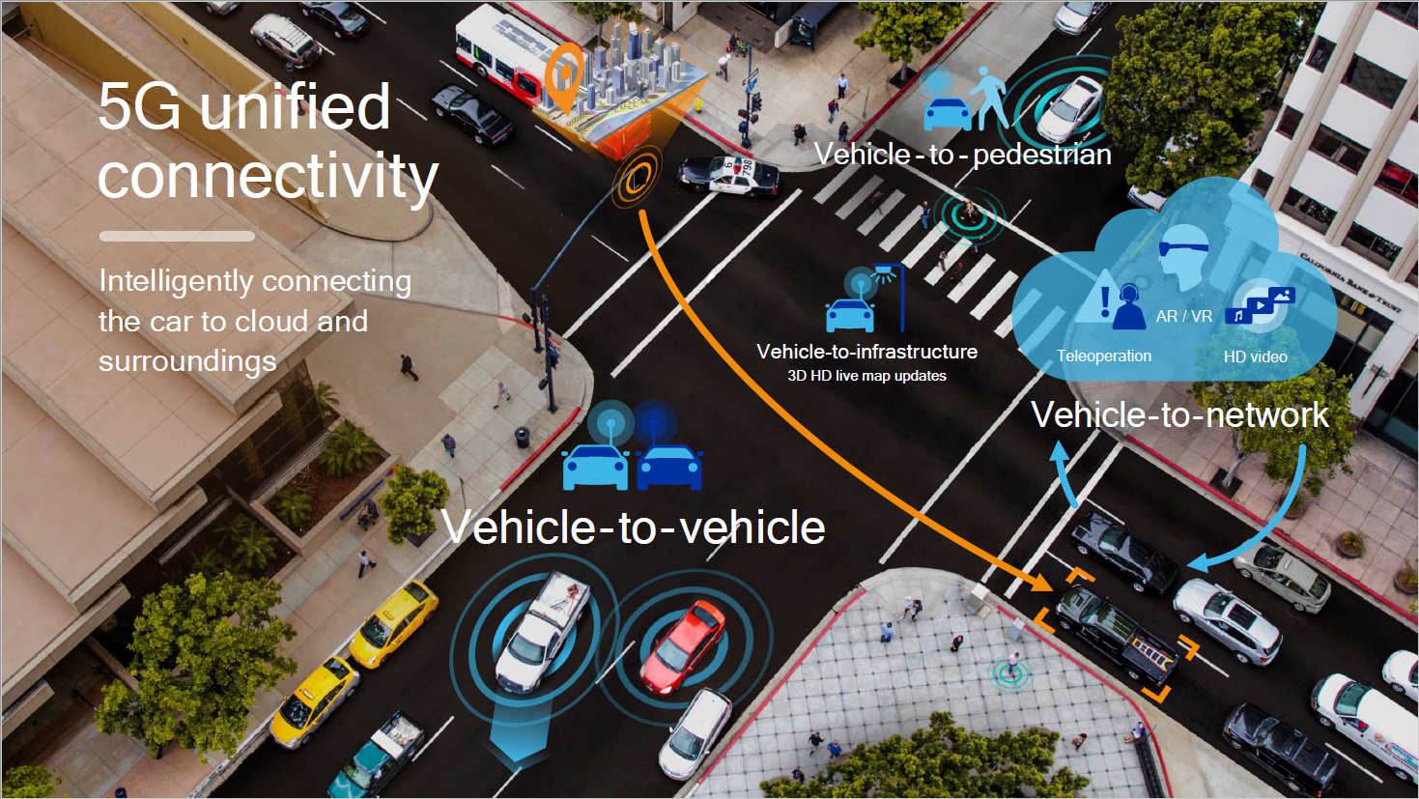
Introduction 5G
Notes:
https://en.wikipedia.org/wiki/Vehicle-to-everything
Vehicle-to-everything (V2X) communication is the passing of information from a vehicle to any entity that may affect the vehicle, and vice versa. It is a vehicular communication system that incorporates other more specific types of communication as V2I (vehicle-to-infrastructure), V2N (vehicle-to-network), V2V (vehicle-to-vehicle), V2P (vehicle-to-pedestrian), V2D (vehicle-to-device) and V2G (vehicle-to-grid).
The main motivations for V2X are road safety, traffic efficiency, and energy savings. There are two types of V2X communication technology depending on the underlying technology being used:
WLAN-based
cellular-based.
Standardization of WLAN-based V2X supersedes that of cellular-based V2X systems. IEEE first published the specification of WLAN-based V2X (IEEE 802.11p) in 2012. It supports direct communication between vehicles (V2V) and between vehicles and infrastructure (V2I). This technology is referred to as Dedicated Short Range Communication (DSRC). DSRC uses the underlying radio communication provided by 802.11p.
In 2016, Toyota became the first automaker globally to introduce automobiles equipped with V2X. These vehicles use DSRC technology and are only for sale in Japan.
In 2017, GM became the second automaker to introduce V2X. GM sells a Cadillac model in the United States that also is equipped with DSRC V2X.
In 2016, 3GPP published V2X specifications based on LTE as the underlying technology. It is generally referred to as "cellular V2X" (C-V2X) to differentiate itself from the 802.11p based V2X technology. In addition to the direct communication (V2V, V2I), C-V2X also supports wide area communication over a cellular network (V2N). This additional mode of communication and native migration path to 5G are two main advantages over 802.11p based V2X system.
As of December 2017, a European automotive manufacturer has announced to deploy V2X technology based on 802.11p from 2019.^{[1]} While some studies and analysis in 2017^{[1]} and 2018,^{[2]} all performed by the 5G Automotive Association (5GAA) – the industry organisation supporting and developing the C-V2X technology – indicate that cellular-based C-V2X technology in direct communication mode is superior to 802.11p in multiple aspects, such as performance, communication range, and reliability, many of these claims are disputed, e.g. in a whitepaper published by NXP,^{[3]} one of the companies active in the 802.11p based V2X technology, but also published by peer-reviewed journals^{[4]}. Industry analysts suggest that both technologies will continue to be used in different regions with the installed base of V2X-equipped vehicles reaching 6 Million by 2022^{[5]}.

Slide 4
Overview: DSRC
The technology was developed specifically for V2V applications that require critical latency of ~100ms, very high reliability and security authentication with privacy safeguards
The Federal Communications Commission (FCC) has allocated dedicated spectrum for transportation safety applications in 1999 in the 5.850-5.925 GHz band to ensure operation without interference that DSRC-based V2V systems plan to leverage.

Slide 5
Overview : DSRC - Weakness
No apparent path for continued evolution of the radio standard
Unable to meet the higher bandwidth demands of V2N applications such as autonomous driving, multimedia services.
DSRC also has limited range: about 300m
DSRC would require the deployment of tens of thousands of roadside units (RSUs) embedded or attached to roadway infrastructure to enable an effective network along the nation’s roads.
Need for another set of radios when all new vehicles already come with embedded cellular radios.

Slide 6
Overview
With LTE Release 14, direct device-to-device communication improves latency and support operation in areas without network coverage and at high relative speeds, while network broadcast capabilites can help to meet other V2X requirements.
April 2015: all new cars to be equipped with eCall technology
The law requires every new vehicle produced after April 2018 to be equipped with integrated cellular technology
The strategy aims support both cellular communications and European Telecommunications Standards Institute - Intelligent Transport Systems - G5 (ETSI ITS-G5), a standard based on IEEE 802.11p and similar to DSRC.
Spectrum resources (European + U.S): 5.9 GHz band

Slide 7
C-V2X Performance Advantage
Qualcom : Slide 25 -43

Slide 8
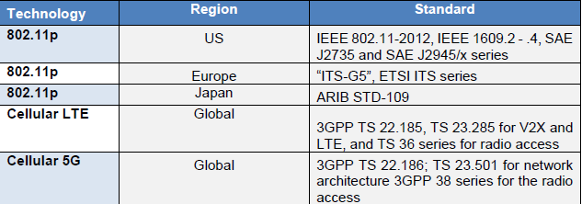
5G V2X: Communication Layer Standard Overview
There are two main technologies: 802.11p and cellular.
There is also a third option—low-power wide-area network (LPWAN)—for V2I special use cases such as smart city parking
Notes:
Reference: 2018_5G_Americas_White_Paper_Cellular_V2X_Communications_Towards_5G__Final_for_Distribution

Slide 9
5G C-V2X: Communication Layer Standard Overview
For V2N, 5G is a converged network supporting heterogeneous access to a common core (5GC).
It is expected that these different technologies will coexist with gateways to interact between the different elements.
A number of other standards support V2X communication networks, such as Network Function Virtualization (NFV) and Multi-access Edge Computing (MEC), both developed by ETSI and being adopted by 3GPP
Notes:
For V2N, 5G is a converged network supporting heterogeneous access to a common core (5GC), and it is expected that these different technologies will coexist with gateways to interact between the different elements. Typically, a vehicle talking 802.11p could send data to a gateway that will then connect to 4G and then 5GC, or directly to 5GC.
As its name implies, MEC brings the service closer to the network edge: therefore, close to the devices’ point of attachment, and precisely why it becomes relevant for V2X. This technology is characterized by proximity to the wireless device, ultra-low latency and high-bandwidth support, location awareness and real-time access to network and context information.
MEC standardization is being done at the ETSI MEC Industry Specification Group (ISG), with the objective of creating an open environment that can support cloud platforms at the edge, possibly spanning multiple vendors. These platforms are then accessible to service providers and third parties, including car manufacturers and application providers. MEC addresses the requirements related to latency and high throughput between the client and the server application. MEC technology is being leveraged by 5G, and it is very beneficial to multiple V2X use cases. For example, real-time situational awareness and high -definition (local) maps can take advantage of MEC due to the real-time and local nature of the information needed for accurate and augmented situational awareness of the road users.

Slide 10
5G C-V2X: Application Layer Standard Evolution
Over the years, and with significant transportation stakeholder input, the SAE DSRC Technical Committee in the U.S. and the ETSI ITS Technical Committee in Europe have developed a set of applications and specific V2X messages ( ➔ only work with access layer to be DSRC/ITS-G5)
Cellular V2X is not limited to short range, ad-hoc message broadcast and reception, but instead includes a wide variety of high-bandwidth applications
Types of messages and services enabled will likely transcend even those combinations available in SAE and ETSI.
The automotive industry has adopted a common framework for automated driving that was developed by the SAE

Slide 11
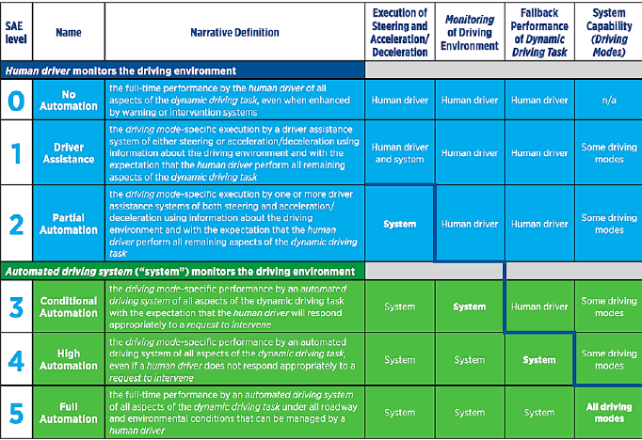
5G C-V2X: Application Layer Standard Evolution
SAE J3016 Levels of Automation (Source: SAE International)

Slide 12
5G C-V2X: Industry Update
On the industry side, there are different actors: vehicle manufacturers, infrastructure providers (road, cities), network operators and the regional institutions/regulators.
A number of cities and infrastructure provider offer solutions with LPWAN combined with cellular in the car.
A number of trials are ongoing around 5G, and V2X is one of the preferred use cases
the ITU and countries need to allocate 5G spectrum, operators need to deploy 5G and on-board unit (OBU) manufacturers need to evolve their existing products to support 5G New Radio (NR) when available

Slide 13
5G C-V2X: EXPECTED BENEFITS
Transportation Safety
Traffic Efficiencies
Infrastructure Savings
Smart Green Environments
Notes:
The NHTSA estimates that safety applications enabled by V2V and V2I could eliminate or mitigate the severity of up to 80 percent of non-impaired crashes, including crashes at intersections or while changing lanes.
The ability to communicate, analyze and react with V2X technology across vehicles, infrastructure and intelligent applications enables cities to provide a variety of intelligent transportation solutions
The city transportation system can gather the real-time data, analyze the traffic pattern and apply deterministic traffic congestion alogirthms for better road management and improved infrastructure planning
Road weather information gathered from the various nodes of the system will be collected and analyzed by transportation management centers, allowing for advanced warnings and more efficient deployment of Department of Transportation (DoT) road crews.
Insurance providers and their policyholders also could benefit because V2X enables more precise information gathering
In the U.S. alone, by 2060, with V2V fully deployed, the proposed NHTSA rule15 is estimated to save approximately 5,631 to 7,613 fatal equivalents annually. Finally, the total associated monetized annual savings would range from $54.7 billion to $73.9 billion. Of these savings, $7.7 billion to $10.6 billion is estimated to be in the form of reduced property damage and congestion.

Slide 14
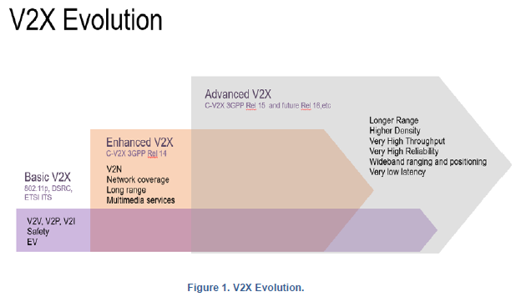
5G V2X Evolution

Slide 15
5G V2X Evolution
5G will support a broad range of V2X and non-V2X use cases, including enhanced Mobile Broadband (eMBB), massive Internet of Things (mIoT) and mission-critical services.
High data rates for eMBB, low power consumption and high scalability for mIoT, and ultra-low latency and high-reliability communications (URLLC) for mission-critical services
A number of technologies are introduced, such as NFV/Software Defined Networking (SDN), Control-User Plane Separation (CUPS), MEC, network slicing, automation and Development and Operations (DevOps)
Notes:
NFV, as defined by ETSI NFV, has started to be implemented in current networks. 3GPP adopted NFV to support 5G, allowing for resource sharing and dynamic scalability across compute, memory/storage and network resources. SDN is also part of 3GPP’s latest specs to support CUPS and allow programmatic access to control the data flows, providing centralized control plane, lowering the cost of the network fabric and bring granularity to the per-packet level.
5G networks also will use MEC. As defined by ETSI MEC, a couple of new concepts and technologies are introduced. The first is a cloud hosting environment at the edge of the network that enables the deployment of virtualized network functions and third-party applications closer to the user and devices. Second is a set of Application Program Interfaces (APIs),mainly radio and location APIs exposed to third-party applications. Virtualization is also an important technology utilized in the implementation of MEC. The MEC hosting infrastructure consists of hardware resources and a virtualization layer. The virtualization manager provides, in brief, an infrastructure-as-a-service (IaaS) capability.
Network slicing allows network operators to define different types of services and allocate dynamically proper resources to support this end-to-end service by configuring different network segments. By using slicing technology, one physical network can be divided in multiple virtual networks, each supporting different service requirements or even different customers. Virtualization, combined with SDN and slicing, enables the network to allocate resources to different slices in a dynamic fashion and reroute dynamically the traffic through the different virtual functions of each slice. The amount of resources allocated can adapt based on traffic conditions. Moreover, traffic from one slice does not impact traffic from other slices. In addition, management of a slice can be delegated to third parties.
Last but not least, management of 5G systems will be much more automated. Starting with continuous integration/continuous delivery (CI/CD), new network functions developed by suppliers are carried over to network operators via programmatic interfaces. Next, those functions are integrated/tested and deployed in live networks through a standard automation environment that will take care of onboarding, instantiation, lifecycle management, update/upgrade and termination. This DevOps system will be associated with analytics that will collect events to monitor the network and services and provide recommendations or trigger actions to reconfigure the network automatically.

Slide 16
5G V2X Evolution: 5G FOR AUTOMOTIVE SECTOR
Initially defined as LTE V2X in 3GPP Release 14
Maintains full backward compatibility to the previous releases of the same generation, enabling service-level interoperability between generations and releases
Release 14 technology is only used for basic safety, while NR technology is used for other (advanced) services, so that Release 14 functionality is not duplicated or replaced.
In order to accelerate the 5G deployment and reduce the initial investment needed by operators, most operators will take a two-phase approach to deploying 5G: Non-Standalone (NSA) and Standalone (SA)
Notes:
Non-Standalone (NSA) operation mode, which is also known as LTE-NR dual connectivity (DC), will be adopted initially, followed by standalone (SA) operation. There are several NSA options being worked on by 3GPP. In option 3, the 5G Radio Access Network’s (RAN’s) control plan is hosted by the LTE eNode-B (eNB). This is the most likely NSA architecture to be standardized in Release 15 and first to be deployed in the field.
Reference: 2018_5G_Americas_White_Paper_Cellular_V2X_Communications_Towards_5G__Final_for_Distribution: Page 14

Slide 17
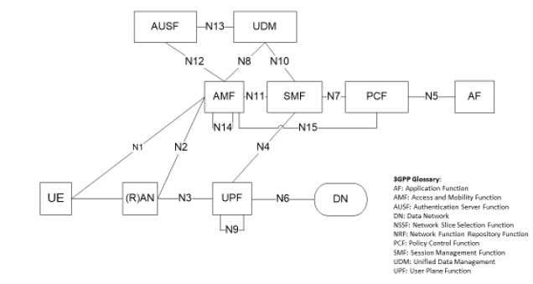
5G V2X Evolution: 5G FOR AUTOMOTIVE SECTOR
5G Latency and Reliability Requirements
10 milliseconds (ms) latency end-to-end
1 ms over-the-air for ultra-low latency design
Transmission Modes
direct mode or infrastructure mode
Architecture
Notes:
The requirements for 5G automotive sector have been addressed by multiple standards bodies and organizations, such as 3GPP,17 5G-Public and Private Partnership (5G-PPP)18 and Next Generation Mobile Networks Alliance (NGMN).19 The 5G Automotive Association (5GAA) is also in the process of finalizing such requirements. There are some minor differences in the requirements, especially regarding latency. At this point, the 5G system is being engineered to support 10 milliseconds (ms) latency end-to-end (to/from the application layer) and 1 ms over-the-air for ultra-low latency design.20 Reliability is also important, targeting 99.999 percent for ultra-reliable transmissions. Currently 3GPP is evaluating which service requirements can be met by LTE and which requirements will need 5G. This will allow a direct mapping between services and use cases into a specific radio access technology.
In the direct mode, two or more mobile devices communicate directly with each other without network assistance. In the infrastructure mode, devices communicate with the network or infrastructure. The messages sent to the network may be intended to a V2X application server or may be intended to other devices nearby, in which case the network will forward the packet to the devices in a larger area.

Slide 18
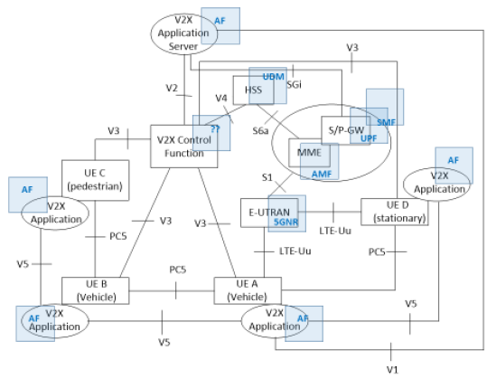
5G C-V2X: Architecture
Notes:
Regarding V2X specifics, the evolution of 3GPP TS 23.28522 Release 14 V2X architecture had not been discussed before the end of 2017. Consequently, there are no standards definitions for how the V2X functions, such as V2X control function and V2X application server or V2X interfaces and protocols, will evolve with 5G.
Typically, the V2X control function is used to provision the subscriber vehicle device with necessary parameters in order to use V2X communication: Public Land Mobile Network (PLMN) specific parameters that allow the device to use V2X in this specific PLMN, or parameters that are needed when the device is not served by the cellular network. The V2X application server is an application server dedicated to V2X applications.
Based on the key 5GC network elements introduced in 3GPP TS 23.501, Figure 4 illustrates the potential V2X architecture evolution
Some of the 4G functions, for example, Evolved Universal Mobile Telecommunications System (UMTS) Terrestrial Radio Access (E-UTRAN), Mobility Management Entity (MME), Serving / PDN Gateway (S/PGW), Home Subscriber Server (HSS), would evolve naturally to the 5G architecture with 5GNR, Access and Mobility Function (AMF), Session Management Function – User Plane Function (SMF-UPF) and Unified Data Management (UDM), while a V2X application server becomes an Application Function (AF) in the 5G architecture terminology. This function can be part of the operator network or be in the domain of a third party. Similarly, as 5G core network design is progressing, the V2X CF of Release 14 will have to be integrated into the architecture.

Slide 19
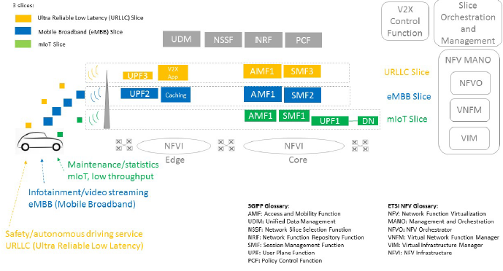
5G C-V2X: Network Slicing
Notes:
V2N and communication via the network are typical use cases for network slicing. For instance, autonomous driving or safety/emergency services would require a Ultra-Reliable Low Latency (URLLC) network slice. Meanwhile, some auxiliary/comfort or personal mobility services would require either a best-effort slice or an eMBB slice in the case of streaming infotainment video. A given vehicle could access different slices at the same time, with passengers watching an HD movie while a see-through application detects a road hazard and triggers an emergency message for the cars behind or nearby to slow down or stop to prevent an accident.
Figure 5 illustrates this scenario. The slices could come from one ‘device’ or multiple devices. In the case of one device, as illustrated in Figure 5 below, 3GPP defined that a given device can support up to eight different slices with a common AMF for all the slices and a SMF per slice. In Figure 5’s example, there are three network slices attached to the same device and sharing the same AMF instance. Slice No. 1 is mIoT and sends data to the core and the data network. Slice No. 2 offers caching at the edge, while slice No. 3 offers access to an edge V2X application

Slide 20
5G C-V2X: Out-of-Coverage Operation
C-V2X can operate outside of network coverage using direct communication without requiring provisioning of a Universal Subscriber Identity Module
Automobile Original Equipment Manufacturers (OEMs) will pre-configure the vehicle device with parameters necessary for out-of-network operation, including:
A list of authorized application classes and the frequencies to use for them
Radio parameters for use on direct link
Configuration for receiving V2X messages via cellular broadcast, for example, Multimedia Broadcast/Multicast Service (MBMS)
These parameters can also be securely updated, if needed,
Vehicle OEMs and mobile operators can work together to ensure the parameters they each provision are compatible, resulting
Notes:
C-V2X can operate outside of network coverage using direct communication without requiring provisioning of a Universal Subscriber Identity Module (USIM). To enable USIM-less communication, automobile Original Equipment Manufacturers (OEMs) will pre-configure the vehicle device with parameters necessary for out-of-network operation, including:24
• Authorization to use V2X
• A list of authorized application classes and the frequencies to use for them
• Radio parameters for use on direct link
• Configuration for receiving V2X messages via cellular broadcast, for example, Multimedia Broadcast/Multicast Service (MBMS)
Direct USIM-less communication allows C-V2X to support critical safety services when network coverage is unavailable or if the vehicle doesn’t have an active cellular subscription. These parameters can also be securely updated, if needed, by the OEM just like any other updates. Vehicle OEMs and mobile operators can work together to ensure the parameters they each provision are compatible, resulting in harmonious operation of various vehicle devices using the direct link in an area.

Slide 21
5G V2X: C-V2X as a New Sensor
Release 16 C-V2X will incorporate 5G NR design features to enable new use cases for automated driving with more stringent requirements
5G C-V2X will become a new type of sensor with ultra-long-range and high accuracy by leveraging vehicles as moving sensor platforms
Notes:
Release 16 C-V2X will incorporate 5G NR design features to enable new use cases for automated driving with more stringent requirements. 5G NR based C-V2X will deliver higher throughput, lower latency and better reliability. In addition to broadcast communication, 5G NR C-V2X will be enhanced to support both unicast and multicast. It will also enable wideband ranging and positioning to deliver more precise (for example, sub-meter) location accuracy.
With these enhanced capabilities, 5G C-V2X will become a new type of sensor with ultra-long-range and high accuracy by leveraging vehicles as moving sensor platforms. For example, in a typical “see-through” use case scenario, a vehicle following a large truck with limited forward visibility can receive high-quality, real-time video feeds from cameras installed on the trunk or other nearby vehicles to gain visibility.
In another example, a cloud-based sensor analytic platform can be established to deliver visibility and accuracy unrivaled by traditional standalone sensors that operates only under line-of-sight conditions. Using 5G C-V2X, this cloud sensor platform can collect a large volume of raw and/or processed sensor data from vehicles in a region. The data is then analyzed in real-time (for example, using artificial intelligence) to identify important objects and events and pinpoint their locations. The results are then streamed to vehicles in real-time together with other relevant data, such as an HD map.
Apart from the enhanced visibility and accuracy, this new C-V2X sensor also provides access to high quality sensor data to vehicles with less-capable on-board sensors, and thus further improves road safety.

Slide 22
5G C-V2X: Security Aspects
As for the direct mode of operation, the security design for the C-V2X26 Release 14 is expected to remain unchanged, namely specifying the reuse of the application-level security already defined by IEEE for DSRC systems.
LTE Release 14 does not support vehicle identity privacy when it sends V2X traffic via the network.
Security for 5G aims to
Define device-to-network authentication methods and transport
Specify provisioning and storage of 3GPP credentials for devices
Specify network functions and protocols necessary for secure device operation within the operation network
Notes:
5G security is still being developed by 3GPP for device to network communications. A Release 15 study was completed and normative phase started in July 2017. The complete 5G system will be specified in Release 16, which is expected to be complete by late 2019. The description below is based on 3GPP25 specification work in progress TS33.501 [version 0.3.0, August 2017].
C-V2X security is unlikely to be updated with Release 15. However, the enhancements developed for network access and associated security aspects will apply to the network-enabled mode of communication. As for the direct mode of operation, the security design for the C-V2X26 Release 14 is expected to remain unchanged, namely specifying the reuse of the application-level security already defined by IEEE for DSRC systems.
Notably, LTE Release 14 does not support vehicle identity privacy when it sends V2X traffic via the network. Architectural changes would be required to support user/vehicle anonymity from the operator. It is currently too early to tell whether the 5G core network will enable network-mode V2X operation privacy.
The model that still stands, is that all security hinges on the security relationship between device and its home operator network. In addition, secondary authentication schemes are allowed in order to support industrial and virtual private networks that wish to deploy their own authentication methods and credentials. With this allowance, it is possible to deploy public key infrastructure (PKI) security, where devices use a digital certificate to authenticate to the network (and likewise the network). It can be speculated this should favor V2X systems where devices are vehicles provisioned with digital certificates and wishing to access the network for V2X applications

Slide 23
5G C-V2X: Security Aspects
So far: 5G security design is being developed to achieve the following goals
Enhanced subscriber/device privacy
Enhanced security support at the network level, along with capability for flexible authentication and authorization schemes
Support various types of devices that have different security capabilities and requirements
Support user data and signaling encryption and integrity protection
Separate device credential management and access authentication from data session setup and management
Support secure slicing
Notes:
• Enhanced subscriber/device privacy: This is a major change from 4G LTE in that the new Subscriber Permanent Identifier (SUPI) is never allowed to be transmitted over the air in the clear. Instead, the sensitive part of the SUPI travels over the radio link protected against spoofing and tracking, which was not the case with the 4G International Mobile Subscriber Identity (IMSI).
• Enhanced security support at the network level, along with capability for flexible authentication and authorization schemes: A new network function is specified: the Security Anchor Function (SEAF) which maintains the security anchor deep in a network (in a physically secure location). SEAF also provides flexibility in deploying other functions (for example, AMF and SMF). In Release 15, the SEAF is collocated with the AMF.
• Support various types of devices that have different security capabilities and requirements: Secondary authentication enables support for non-3GPP access links and sessions authorized by third-party servers, such as for IoT, V2X and industrial automation. This functionality is related to the access control for network slices. For example, IoT devices may require different credential provisioning and authentication method. The details for this type of industrial scenarios are still being worked on.
• Support user data and signaling encryption and integrity protection: These features are essential for a secure system, which is why 5G supports them. A new feature is data path integrity protection, which may be especially important for certain new services (for example, IoT). There is also the potential for the user plane security to be terminated in the network instead of the base station.
• Separate device credential management and access authentication from data session setup and management: This split results in a separate security context between device and the AMF which is used for mobility management (therefore, only to grant the device access to the network). A different security context is established for session management, between device and an SMF, used to authorize access of the device to specific services (for example, slices or specific data networks such as corporate networks, industrial systems). This new type of access control employs a separate authentication and authorization procedure in a flexible way (therefore, based on the Extensible Authentication Protocol (EAP)).
• Support secure slicing: There could be several services instantiated as a network slice, each with different security requirements. The access to a slice is granted based on the primary authentication and subscription information, but this authorization is carried out by the respective SMF. This way, the access security is contained within that network slice and does not rely on the AMF, which may serve multiple slices that may have different security requirements. Moreover, an attack mounted on one slice does not result in an increased risk for an attack on a different slice of the same network.

Slide 24
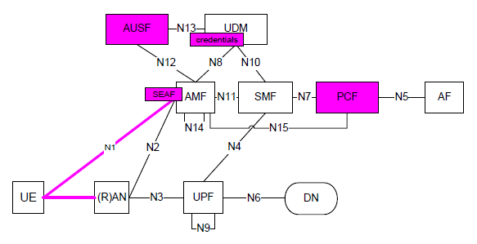
5G C-V2X: Security Aspects
5G Core Network Security Functions

Slide 25
5G C-V2X: C-V2X AND DSRC COMPARISON
Longer C-V2X Range and better reliability for Enhanced Safety
Consistent C-V2X Performance Even in Congestion Conditions
Evolution Path Toward 5G
Notes:
Page 21
Safety messages are generally transmitted more or less periodically for a given duration. C-V2X is designed to leverage these quasi-periodic traffic arrival patterns to deterministically pre-allocate resources for subsequent traffic arrivals. This semi-persistent scheduling mechanism ensures that resources are available when traffic arrives. There is no need to go through resource contention procedures for subsequent traffic, thus allowing C-V2X to maintain low latency even as vehicle density increases.
In addition, to improve channel access when traffic load is high, C-V2X selects the best resource, rather than the first available one, for traffic transmission. A vehicle with pending traffic first measures the relative energy levels of the available radio resource blocks averaged over a short period of time. It then ranks the radio resource blocks and selects one for transmission among those with the lowest relative energy levels. This least-energy resource selection scheme delivers better signal quality in the presence of other transmitting vehicles. Figure 9 (a) illustrates a scenario where C-V2X allows vehicles A and B to transmit simultaneously to their respective recipients. Figure 9 (b) illustrates the corresponding DSRC scenario when vehicle A is transmitting, and vehicle B backs off to avoid collision. C-V2X enables graceful degradation (decrease in range) in the face of congestion, while in DSRC, more abrupt changes in packet transmission rate occur in time, in extreme cases leading to lack of service.

Slide 26
5G C-V2X: ADVANCED USE CASES
ADVANCED DRIVING WITH INTENT/TRAJECTORY SHARING
High bandwidth to support burst transmission of large quantities of data
10 ms latency for highest degree of automation
99.99 percent message reliability for highest degree of automation
Notes:
Page 24
Advanced drivingenables semi- or fully autonomous driving. Longer inter-vehicle distance is assumed.
Each vehicle and/or RSU shares data obtained from its local sensors with vehicles in proximity, thus allowing vehicles to coordinate their trajectories or maneuvers.
In addition, each vehicle shares its driving intention with vehicles in proximity. The benefits of this use case group are safer traveling, collision avoidance and improved traffic efficiency.

Slide 27
5G C-V2X: EXTENDED SENSORS
Extended sensors enable the sharing of raw and processed sensor data (for example, cameras, radar, lidar) among vehicles, RSUs, pedestrians and V2X application servers
High bandwidth to support burst transmission of large quantities of data
Less than 10 ms latency
High message reliability of 95 percent
High connection density to support congested areas (for example, 15,000 vehicles per mile at a congested highway intersection)
Notes:
Extended sensors refer to the ability of vehicles to obtain information about objects around them located beyond the view of their own onboard sensors31 Other nearby vehicles that can detect these objects process them, then broadcast them out to aid other vehicles around in building up a more complete picture of the road world. Overall, this provides vehicles in an area a more complete picture of the traffic environment. Current work on this aspect is taking place in ETSI ITS and 5GAA.
Extended sensors enable the sharing of raw and processed sensor data (for example, cameras, radar, lidar) among vehicles, RSUs, pedestrians and V2X application servers. The sensor data that a vehicle can share ranges from a photo of a perceived object to its real-time video stream. The availability of sensor data from multiple disparate sources enhances situation awareness of the vehicles and pedestrians, and thus improves road safety. Extended sensors also enable new features and capabilities such as cooperative driving and precise positioning, which is necessary for autonomous driving.
As an example, vehicles send messages that provide Non-Line-of-Sight (NLOS) awareness to other vehicles. This is particularly important intersections/on-ramps, or where environmental conditions (for example, rain, fog, snow) impair the range of the onboard sensors. In Figure 19, the red car warns about the cyclist behind it, which the yellow car cannot see.

Slide 28
5G C-V2X: PLATOONING
Platooning allows vehicles to form a tightly coordinated “train” with significantly reduced inter-vehicle distance, thus increasing road capacity and efficiency.
25 ms end-to-end communication latency among a group of vehicles (10 ms for the highest degree of automation)
90 percent message reliability, and 99.99 percent for the highest degree of automation
Relative longitudinal position accuracy of less than 0.5 m
10 to 30 messages per second of broadcasting rate
Dynamic communication range control to improve resource efficiency given the varying platoon size, and to limit message distribution for privacy reasons
Notes:
Platooning allows vehicles to form a tightly coordinated “train” with significantly reduced inter-vehicle distance, thus increasing road capacity and efficiency. It also improves fuel efficiency, reduces accident rate and enhances productivity by freeing up drivers to perform other tasks.
Vehicles within a platoon must be able to exchange information periodically (for example, to share status information such as speed and heading) and to send event announcements such as braking and acceleration. There are several aspects of platooning that must be supported through reliable V2V communications:
• Joining and leaving a platoon: to allow a vehicle to signal its intention to join or to leave a platoon at any time while the platoon is active, and to support additional signaling to complete the join/leave operations
• Announcement and warning: to indicate the formation and existence of the platoon so that nearby vehicles can select to join the platoon or to avoid disruptions to the platoon
• Steady state operation group communication: to support the exchange of platoon management messages also to indicate braking, acceleration, which road to take, change of platoon leader, etc.
Given the small target inter-vehicle distance while the vehicles are traveling at relatively high speed, V2V communication must be able to support reliable, high duty cycles and secure message exchange to ensure effective and safe platooning operation

Slide 29
5G C-V2X: REMOTE DRIVING
Remote driving enables the remote control of a vehicle by a human operator or by a cloud-based application, via V2N communication
Remote driving can be used in a way to lower the cost of fully autonomous driving for certain use cases because of the lower technical requirements
Level 4 or 5 autonomous vehicle
Data rate up to 1 Mbps downlink and 25 Mbps at uplink (assuming two H.265/ HEVC HD stream up to 10 Mb/s each)
Ultra-high reliability at 99.999 percent or higher (URLLC)
End-to-end latency of 5 ms between the V2X application server and the vehicle
Vehicular speed of up to 250 km/h
Notes:
Remote driving enables the remote control of a vehicle by a human operator or by a cloud-based application, via V2N communication.33 There are several scenarios that can leverage remote driving, including:
• Provide a backup solution for autonomous vehicles. An example is during the initial autonomous vehicle deployment when a vehicle is in an unfamiliar environment and has difficulty navigating, a remote operator can take control.
• Provide remote driver services to youth, elderly and others who are not licensed or able to drive.
• Enable fleet owners to remotely control their vehicles. Examples including moving trucks from one location to another, delivering rental cars to customers and providing remotely driven taxi services.
• Enable cloud-driven public transportation and private shuttles, all of which are particularly suitable for services with predefined stops and routes.
Remote driving can be used in a way to lower the cost of fully autonomous driving for certain use cases because of the lower technical requirements (for example, smaller number of in-vehicle sensors and less computation requirements for sophisticated algorithms). The following are some potential V2X requirements for supporting remote driving:
• Data rate up to 1 Mbps downlink and 25 Mbps at uplink (assuming two H.265/ HEVC HD stream up to 10 Mb/s each)
• Ultra-high reliability at 99.999 percent or higher (URLLC)
• End-to-end latency of 5 ms between the V2X application server and the vehicle
• Vehicular speed of up to 250 km/h
Remote control/driving will be required when an obstacle blocks a Level 4 or 5 autonomous vehicle, rendering it unable to decide about a pathway or approach to safely navigate around it. Examples of obstacles include lanes that are blocked due to a proximate accident, double-parked cars not allowing the vehicle to pass without crossing the ingress/egress yellow lines or unexpected or never experienced situations where the vehicle is unable to make a determination on a safe action or does not know how to proceed.
When the vehicle encounters such a situation, it will stop or find a minimum risk position and then will request the assistance of a remote-control operator to take control and drive it around the obstacle. For the remote controller to understand the obstacle and determine the pathway the vehicle must take, the controller will utilize the streaming sensor information (for example, video, lidar, radar) that has been temporarily made available to him or her. Once cleared of the obstacle, the stream to the controller will cease and the vehicle will be back in full control towards its destination. This solution will require precision and will need to be limited to ensure high customer satisfaction, as well as to limit the traffic impediment a stopped autonomous will cause

Slide 30
5G C-V2X: DATA UPLINK
Automated vehicles generate upwards of 4 TB34 per day from various sensors such as radar, lidar and cameras
These data sets are utilized within various stages of vehicle system development and consumer usage
During the development/trial phase: developing various deep learning models
After the vehicle is sold: periodically tuned with new data sets from live drives .
Notes:
Automated vehicles generate upwards of 4 TB34 per day from various sensors such as radar, lidar and cameras. These data sets are utilized within various stages of vehicle system development and consumer usage. During the development/trial phase, the majority of the sensor data is stored within in-vehicle storage and transported to data center platforms for developing various deep learning models, which are in turn deployed in vehicles for live object detection and classification. After the vehicle is sold, these models are periodically tuned with new data sets from live drives. Various wireless data uplink methods will be required depending on specific data modalities such as sensor data, vehicle diagnostics, positioning data and real-time situational data.

Slide 31
5G C-V2X: REAL-TIME HD MAPPING
Real-time HD mapping is a critical ingredient for automated driving, although technical implementation strategies vary
In “map-light” approaches, high-definition maps are primarily used for navigation purposes and will be overlaid with real-time situational data (for example, accident notification, road construction
In “map-heavy” approaches, HD maps play a much more critical role in path planning—even to a centimeter level of detail.
Notes:
Real-time HD mapping is a critical ingredient for automated driving, although technical implementation strategies vary. In “map-light” approaches, high-definition maps are primarily used for navigation purposes and will be overlaid with real-time situational data (for example, accident notification, road construction).
In “map-heavy” approaches, HD maps play a much more critical role in path planning—even to a centimeter level of detail. Such scenarios will require maps that may be up to 1 TB in size for a single city/neighborhood. Not only will these maps need to be updated periodically without direct user interaction, they may even require on-demand updates as vehicles move across geographies. Deployment strategies that leverage roadside infrastructure and edge cloud solutions to deliver these map updates will become crucial to keep costs down.

Slide 32
5G C-V2X: STAKEHOLDERS AND THEIR ROLES
MOBILE NETWORK OPERATORS
VEHICLE MANUFACTURERS
SPECTRUM AND REGULATORY ASPECTS
THE ROLE OF CLOUD SERVICE PROVIDERS
support mobile operators
offering global SIM card management for connected cars and ecosystem management
providing data centres that complement operators’ clouds and edge clouds.
In parallel, a number of car manufacturers are signing up contracts with cloud service providers to host or leverage data collection-management and analytics platforms, as well as API management and ecosystem management platforms
the role of cloud service provider could increase to supplement network operators’ capabilities.
Notes:
Cloud service providers’ role in V2X could increase with 5G. They already support mobile operators by offering global SIM card management for connected cars and ecosystem management, and by providing data centres that complement operators’ clouds and edge clouds. In parallel, a number of car manufacturers are signing up contracts with cloud service providers to host or leverage data collection-management and analytics platforms, as well as API management and ecosystem management platforms. With 5G and more dynamic networks, more open ecosystem, less predictable traffic, the role of cloud service provider could increase to supplement network operators’ capabilities.

Slide 33
CONCLUSION
The vision to go beyond cellular connectivity towards V2X communication is also becoming a reality.
The V2X communication based on LTE has already been standardized by 3GPP Release 14. Now automotive manufacturers, chip providers, network equipment providers and network operators along with network operators/communication service providers are already completing trails in the U.S. and Europe
The 5G-based V2X solutions that 3PP is working towards standardizing aim to provide advanced V2X use cases leveraging the enhancement that 5G will bring to the radio access and network infrastructure.
The basic safety services for which Release 14 LTE-based V2X was designed will remain an integral part of the V2X communication ecosystem.
With 3GPP Releases 15 and 16, 5G will add advanced V2X features with longer range, higher density, very high throughput and reliability, sub-meter positioning and ultra-low latency.
Notes:
The connected car market is already a mainstream reality; it is leveraging cellular connectivity to provide telematics, connectivity and improved use experience. The vision to go beyond cellular connectivity towards V2X communication is also becoming a reality.
The V2X communication based on LTE has already been standardized by 3GPP Release 14. Now automotive manufacturers, chip providers, network equipment providers and network operators along with network operators/communication service providers are already completing trails in the U.S. and Europe.
The 5G-based V2X solutions that 3PP is working towards standardizing aim to provide advanced V2X use cases leveraging the enhancement that 5G will bring to the radio access and network infrastructure. With 3GPP Releases 15 and 16, 5G will add advanced V2X features with longer range, higher density, very high throughput and reliability, sub-meter positioning and ultra-low latency. The basic safety services for which Release 14 LTE-based V2X was designed will remain an integral part of the V2X communication ecosystem.

Slide 34

Q&A

Slide 35
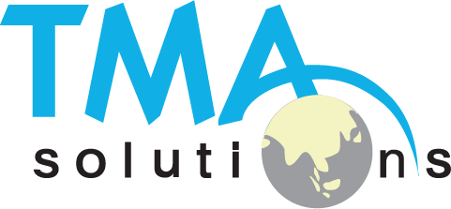
THANK YOU !
Tel:
Mobile:
Fax:
Email:
+84 8 3997-8000
+84 908-676-212
+84 8 3990-3303
sales@tmasolutions.com
North America number:
Australia number:
Japan number:
Website:
+ 1 802-735-1392
+ 61 414-734-277
+81 3-6432-4994
www.tmasolutions.com

